Slide 1
ROCKBUSTER STEALTH strategy – 2020
By Prateek Sharma

Slide 2
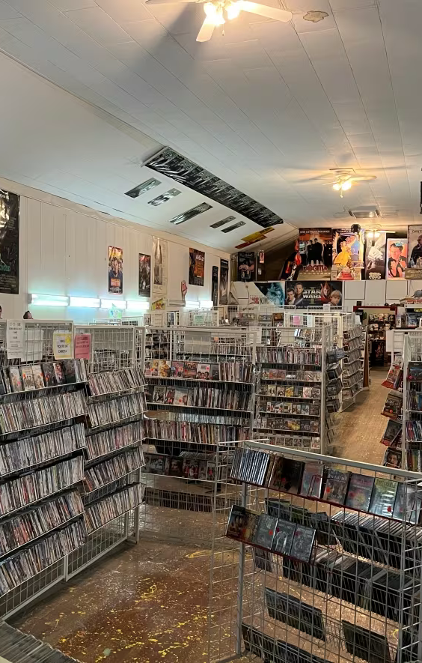
Objective:
To use Rockbuster Stealth LLC’s existing movie licenses to launch an online video rental service to stay competitive among emerging streaming service providers as Netflix and Amazon Prime.

Slide 3

Key Questions:
Which movies contributed the most/least to revenue gain?
What was the average rental duration for all videos?
Which countries are Rockbuster customers based in?
Where are customers with a high lifetime value based?
Do sales figure vary between geographic regions?

Slide 4


Data Overview:
FILMS | CUSTOMERS
17 Categories | 599 total customers
Top 5 genre – Sports, Foreign, Family, Documentary, Animation | 97.5% (584) are active users
1000 films in total and all are in English language | Clientele spread across 108 diverse nations
Top 2 rating categories – PG-13 & NC-17 | Customers are predominantly located in three countries – India, China, United States
Average movie duration – 115.30 mins | Generated $61,312 in revenue from 16044 rental transactions

Slide 5
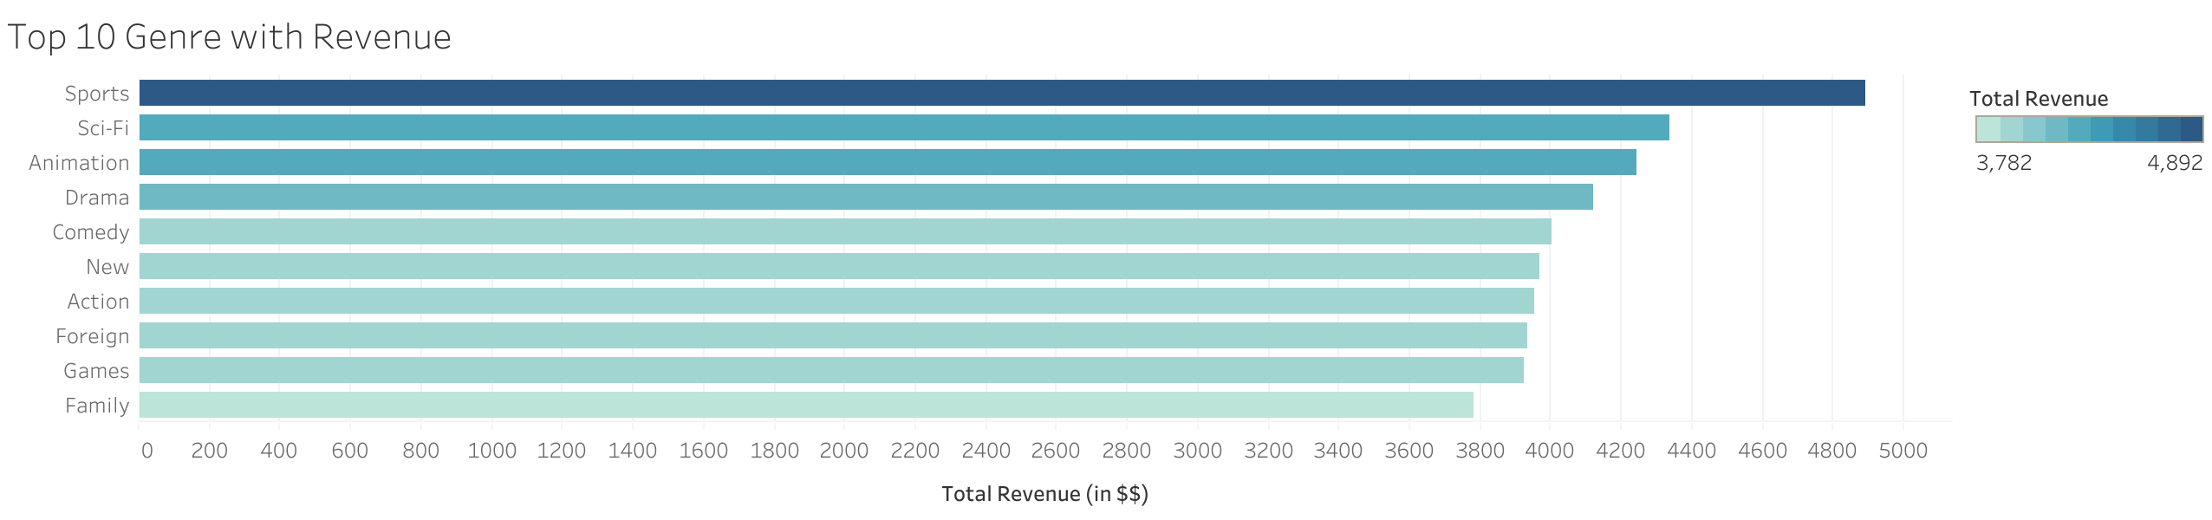
Highest Grossing Genre

Slide 6
Which movies contributed the most/least to revenue gain?
Top 10 films
Bottom 10 films
Telegraph Voyage
Zorro Ark
Wife Turn
Innocent Usual
Hustler Party
Saturday Lambs
Titans Jerk
Harry Idaho
Torque Bound
Dogma Family
$215.75
$199.72
$198.73
$191.74
$190.78
$190.74
$186.73
$177.73
$169.76
$168.72
Oklahoma Jumanji
Duffel Apocalypse
Texas Watch
Freedom Cleopatra
Young Language
Rebel Airport
Cruelty Unforgiven
Treatment Jekyll
Lights Deer
Japanese Run
$5.94
$5.94
$5.94
$5.95
$6.93
$6.93
$6.94
$6.94
$7.93
$7.94

Slide 7
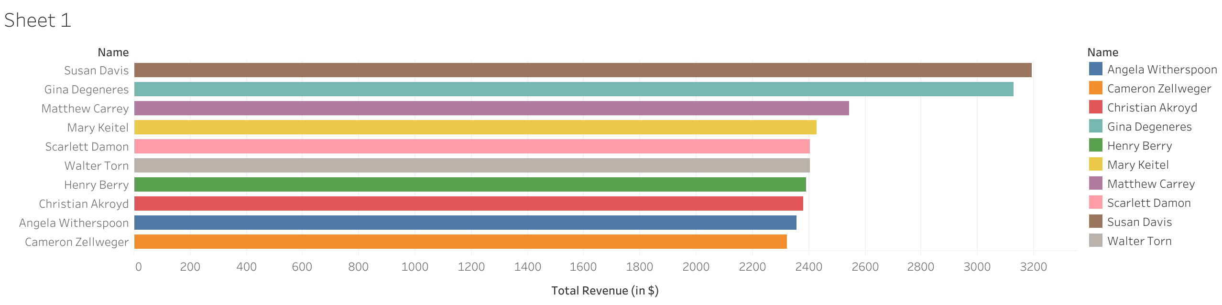
Highest Grossing Actors
Susan Davis and Gina Degeneres are leading the grossing list.

Slide 8
Rental Duration for all Movies
Duration | Days
Minimum | 3
Average | 5
Maximum | 7
Our customer base indicates an average movie rental duration of approximately 5 days.

Slide 9
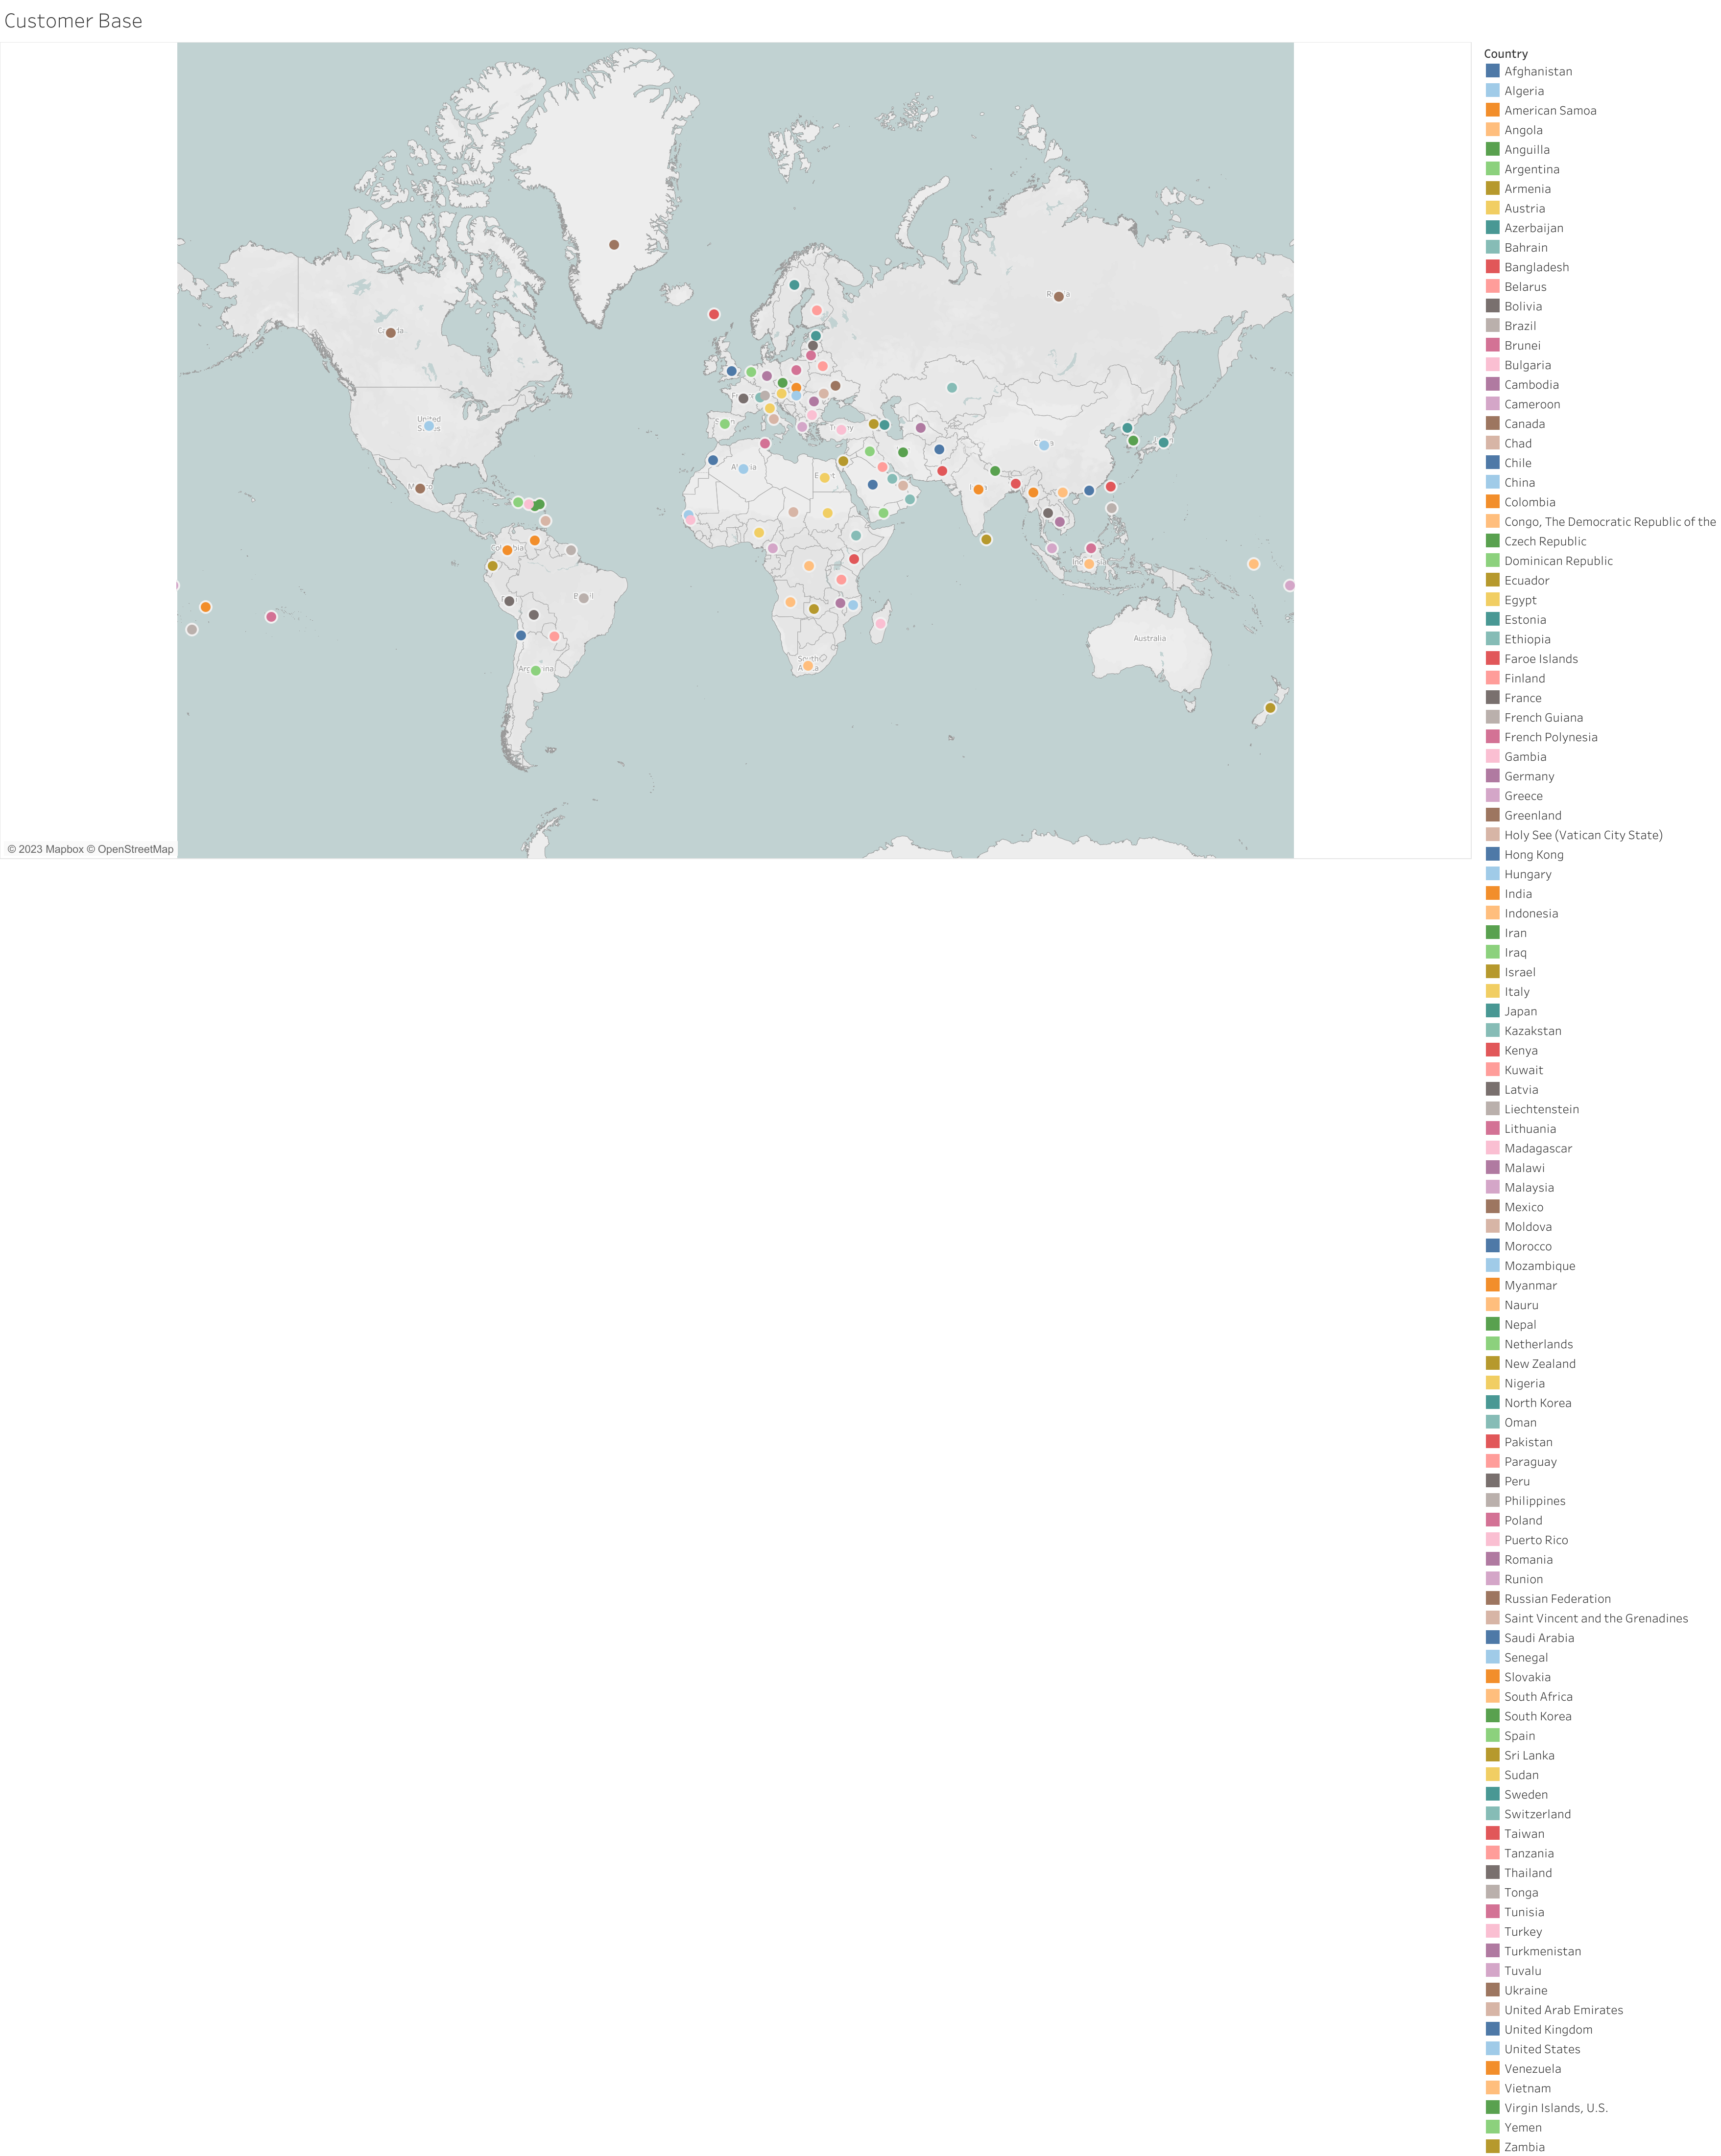
Countries where Rockbuster customers are based
Different color bubbles shows all the countries where customers are located.

Slide 10
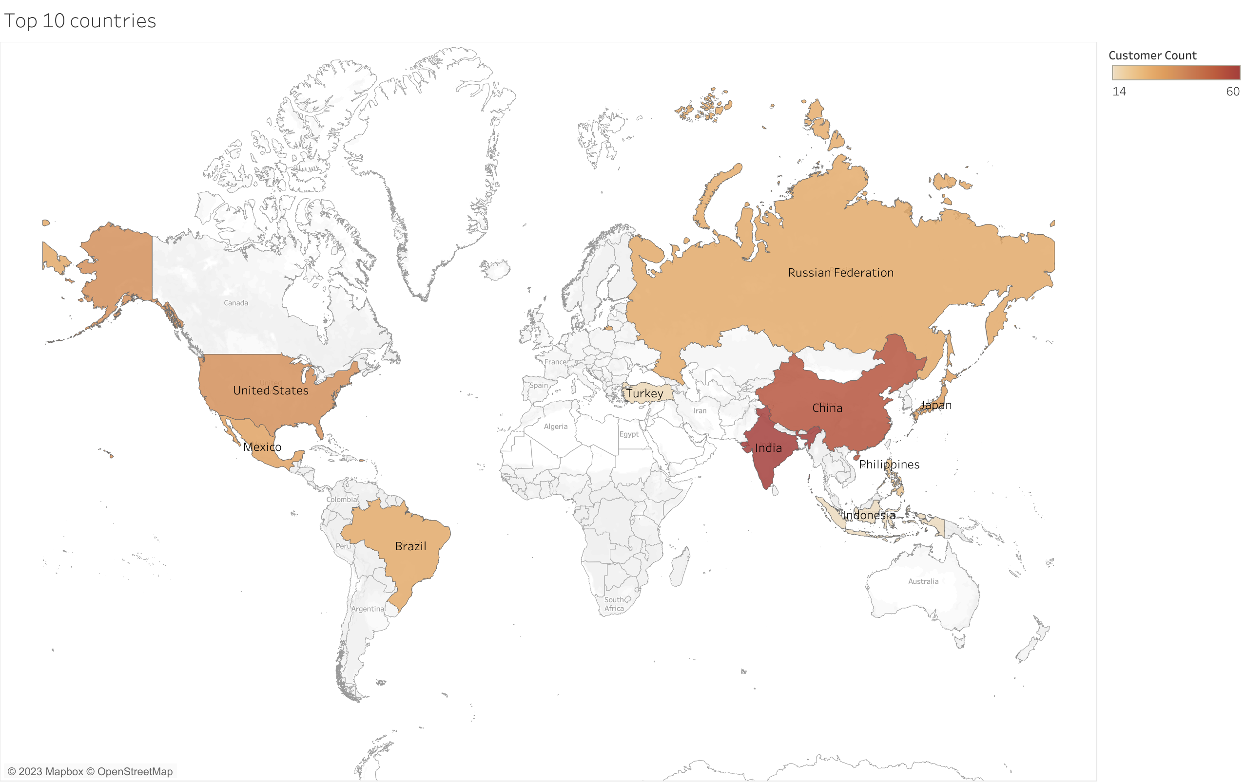
Top 10 Countries with Most Customers
Dark brown color represents the highest customer concentration, as the shade gets lighter so does the customer count.
Asia and Southeast Asia accounts for approx. 57% of customers for Rockbuster.

Slide 11
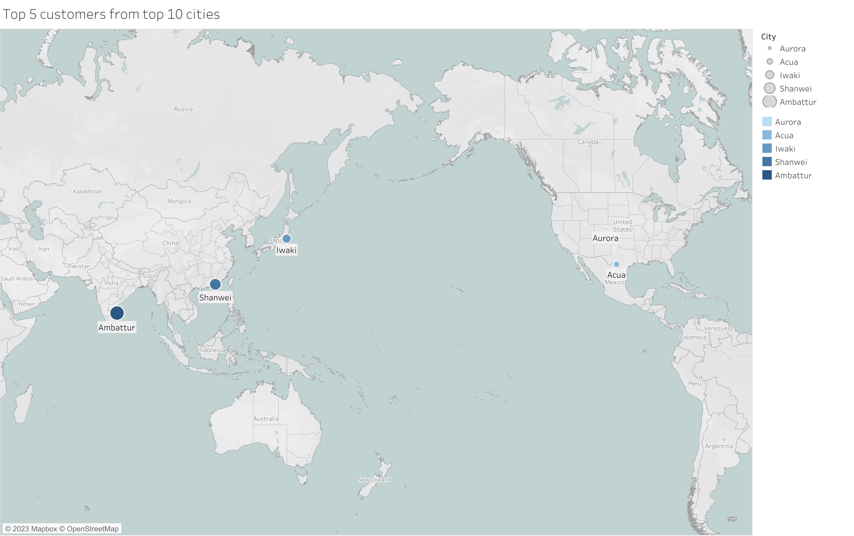
Customers with a High Lifetime Value
Frist Name | Last Name | City | Country | Total Paid
Arlene | Harvey | Ambattur | India | $111.76
Kyle | Spurlock | Shanwei | China | $109.71
Marlene | Welch | Iwaki | Japan | $106.77
Glen | Talbert | Acua | Mexico | $100.77
Clinton | Buford | Aurora | United States | $98.76
Top 5 paying customers within the top 5 cities.

Slide 12
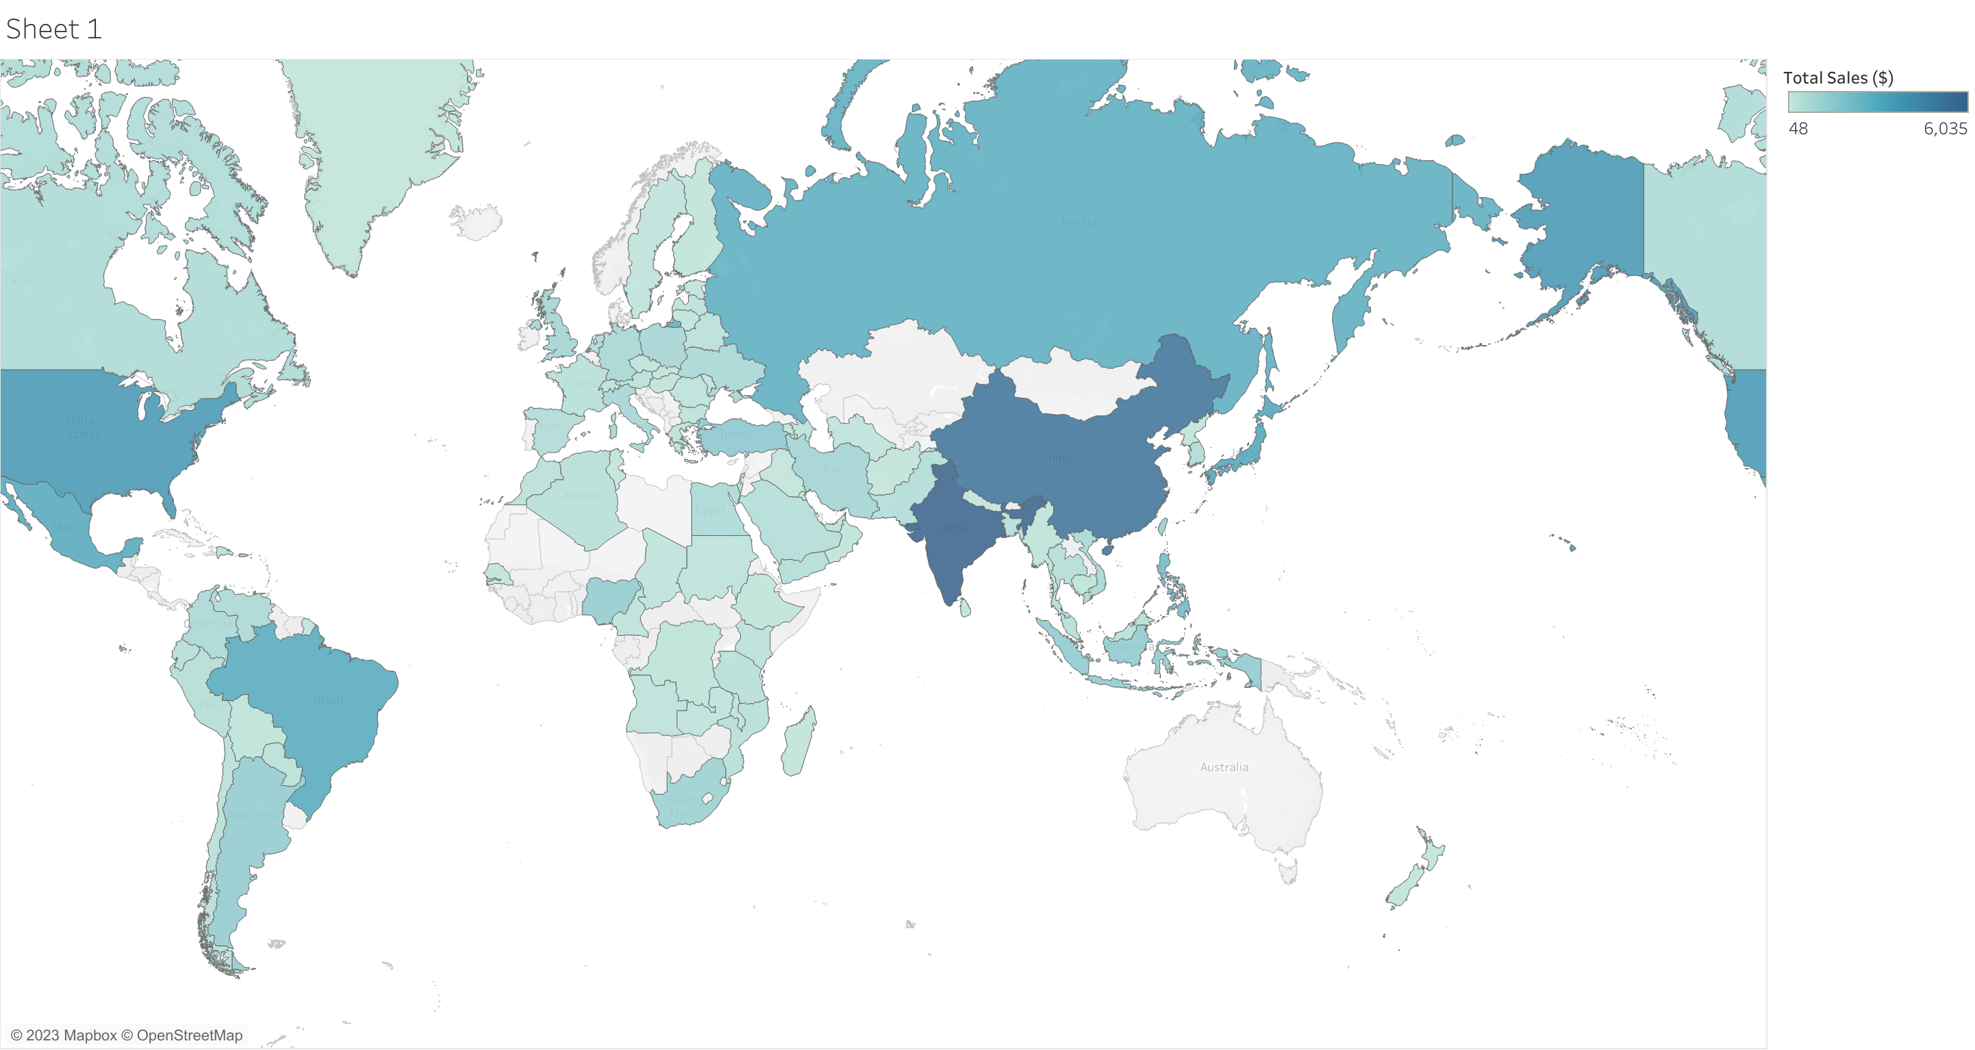
Sales figures between Geographic regions
Country | Sales ($)
INDIA | 6035
CHINA | 5251
USA | 3685
JAPAN | 3122
MEXICO | 2985
BRAZIL | 2919
RUSSIA | 2766
PHILIPPINES | 2220
TURKEY | 1498
INDONESIA | 1353
Top 10 Countries

Slide 13
Recommendations:
Renew licenses for top 10 films and phase out the bottom 10.
Introduce exclusive discounts, incentives for loyal customers and create a point based loyal program to reward customers for repeat purchases.
Allocate 40% of the marketing budget to the top 10 countries to push sales further and the other 35% to revive the slow regions and 25% on extremely low purchase zones.
Promote subscription-based models with bundle options, offer personalized recommendations and flexible rental periods, increase engagement by encouraging customers to share experiences online.
Consider focusing on Sports and Sci-fi category, rated PG-13 and or NC-17 featuring Susan Davis or Gina DeGeneres or Mathew Carrey.

Slide 14
THANK YOU!
For your attention
Any Questions?

Slide 15
Appendix
Top 10 Genre
https://public.tableau.com/app/profile/prateek.sharma7184/viz/Top10Genre_17023129392240/Sheet1
Top 10 Countries by revenue
https://public.tableau.com/app/profile/prateek.sharma7184/viz/Top10countries_17023158352810/Sheet1
Customer Base
https://public.tableau.com/app/profile/prateek.sharma7184/viz/Customerbase/Sheet1
Top 5 Cities
https://public.tableau.com/app/profile/prateek.sharma7184/viz/Top5cities_17023220942420/Sheet1
Sales by rating
https://public.tableau.com/app/profile/prateek.sharma7184/viz/Salesforratings/Sheet
Highest revenue generating actors
https://public.tableau.com/app/profile/prateek.sharma7184/viz/Highestrevenuegeneratedbyactors/Sheet1
Sales by geography
https://public.tableau.com/app/profile/prateek.sharma7184/viz/Salesbygeography_17023268209060/Sheet1

